Slide 1


P1
DNS AND DHCP SERVER ADMINISTRATION ON LINUX- CENT OS
GUIDED BY-
Zakir Hussain
DONE BY -
Anuja Dixit
Anmol Baghel
Mansi Singh
Gaurav Gupta
K Dushyant Reddy
Mainak Roy
Ankit Naharia

Slide 2
TABLE OF CONTENT
Introduction to DNS and DHCP
DNS Server Overview
DHCP Server Overview
DNS Server Configuration and Management
DHCP Server Configuration and Management
Conclusion

Slide 3
INTRODUCTION TO DNS AND DHCP
DNS, is a fundamental component of the internet that functions as a distributed database. Its primary purpose is to translate user-friendly domain names into corresponding IP addresses. This translation enables computers and servers to locate and communicate with each other across the internet.
Dynamic Host Configuration Protocol (DHCP) server administration involves managing and configuring a network server that automatically assigns IP addresses and other network configurations (such as subnet mask, default gateway, and DNS servers) to devices (clients) within a network. This process eliminates the need for manual IP configuration, making it easier to manage large networks.

Slide 4
DNS SERVER OVERVIEW
In the context of CentOS (a Linux distribution), "named" refers to BIND (Berkeley Internet Name Domain), which is the most widely used DNS software on the internet. BIND provides the tools necessary to set up and maintain a DNS server on CentOS, allowing it to resolve domain names to IP addresses and vice versa. Setting up a DNS server on CentOS typically involves installing the BIND package and configuring the named service through its configuration files. These zones can include domain names for which the CentOS server is responsible for providing DNS information.
Components Covered:
Installing BIND
Configuring BIND
Setting Up DNS Zones
Starting BIND Service
Configuring Firewall
Client Configuration and Testing

Slide 5
DHCP SERVER OVERVIEW
Steps for DHCP Server Administration on CentOS 9
Install the DHCP Server Package.
Edit the DHCP Configuration File.
Specify Subnet and Network Parameters.
Set File Permissions (if required).
Start and Enable the DHCP Service.
Allow DHCP Through the Firewall.
Verify DHCP Service Status.
Configure VirtualBox Network Settings (if using a virtual environment).
Test DHCP Functionality with a Client Machine.
Troubleshoot and Resolve Common Issues.

Slide 6
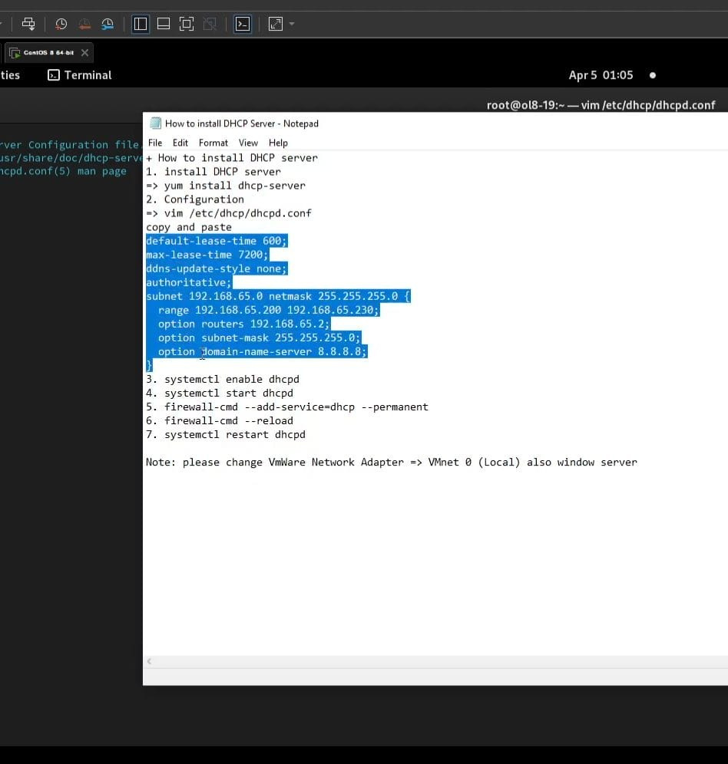
DHCP

Slide 7
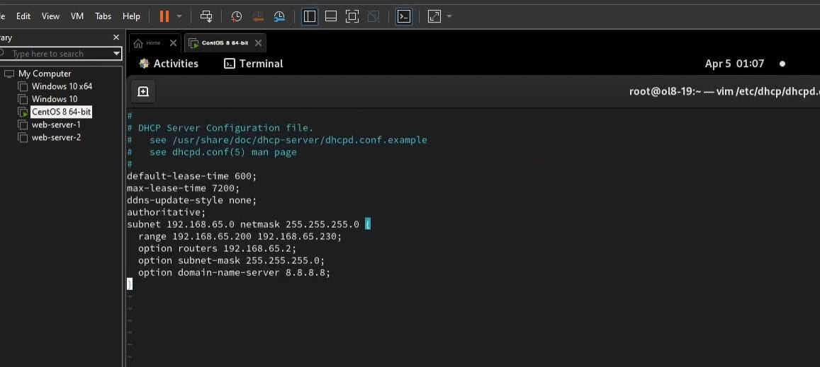
DHCP
1

Slide 8
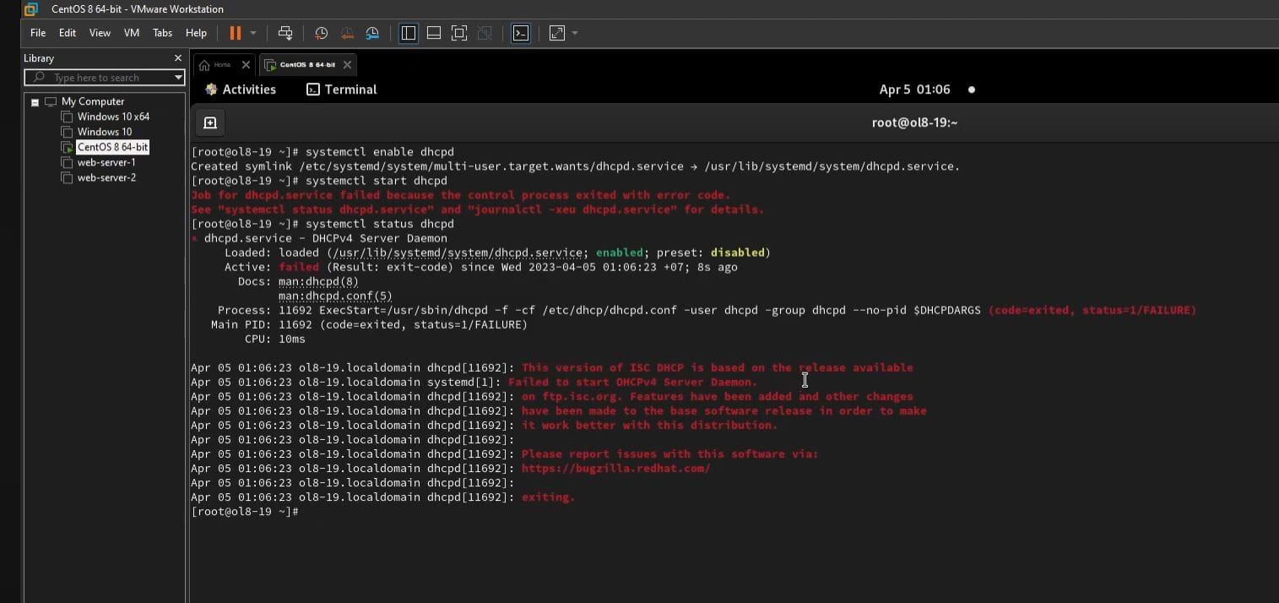
DHCP
2

Slide 9
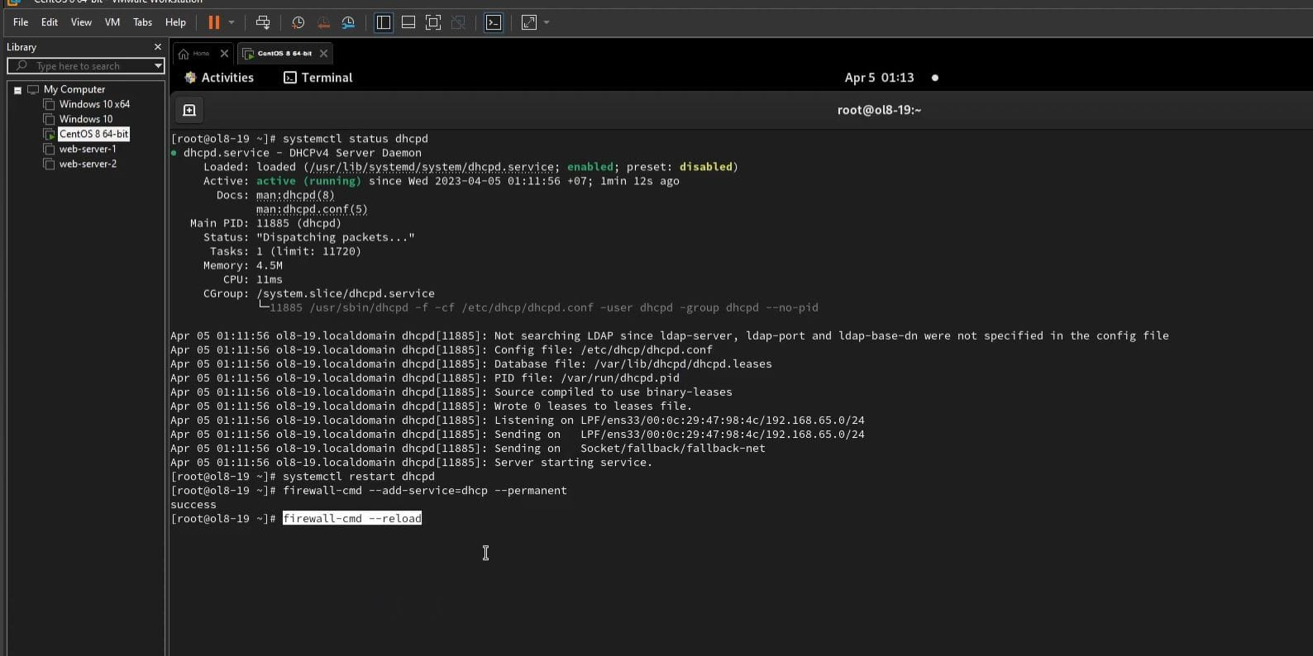
DHCP
3

Slide 10
DNS
Summary of Commands
Install BIND and Utilities:
sudo dnf install bind bind-utils
Edit Configuration:
sudo nano /etc/named.conf
Create Zone File:
sudo nano /var/named/example.com.zone
Set Permissions:
sudo chown named:named /var/named/example.com.zone
Start and Enable BIND:
sudo systemctl start named
sudo systemctl enable named
Allow DNS Through Firewall:
sudo firewall-cmd --add-service=dns --permanent
sudo firewall-cmd --reload
Test DNS Server:
dig @localhost example.com
Configure Client DNS:
sudo nano /etc/resolv.conf
Verify DNS Resolution:
dig example.com

Slide 11
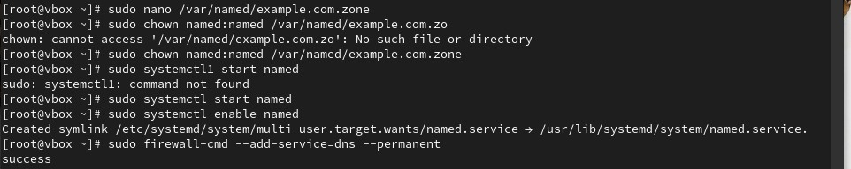
DNS

Slide 12
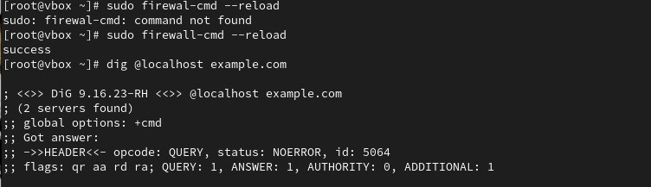
DNS

Slide 13
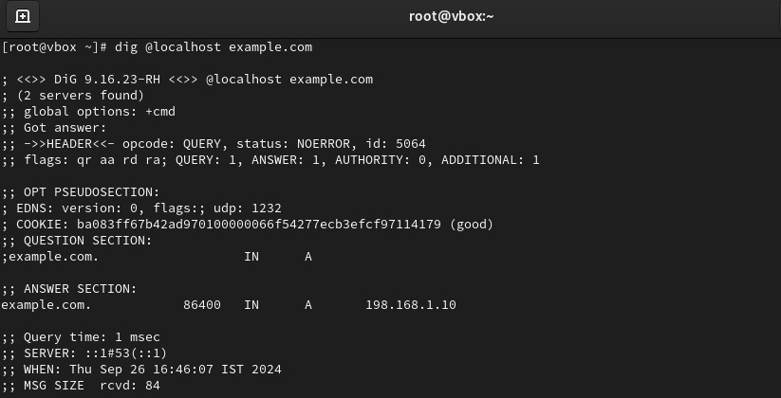
DNS

Slide 14
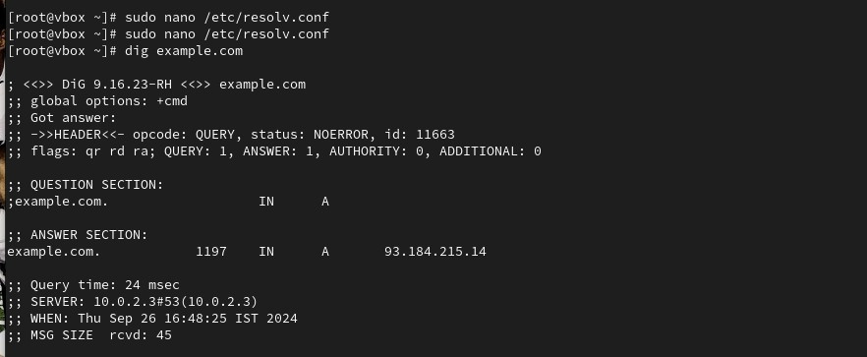
DNS

Slide 15
CONCLUSION
WE SUCCESSFULLY CONFIGURED AND MANAGED DHCP AND DNS SERVERS ON CENTOS LINUX, ENABLING AUTOMATIC IP ASSIGNMENT AND DOMAIN NAME RESOLUTION.PROPERLY CONFIGURED DHCP AND DNS SERVERS ARE CRUCIAL FOR EFFICIENT AND SEAMLESS NETWORK OPERATIONS, PROVIDING AUTOMATED MANAGEMENT AND CENTRALIZED CONTROL OF NETWORK RESOURCES IN BOTH SMALL AND LARGE-SCALE ENVIRONMENTS.

Slide 16
THANK YOU

